Slide 1
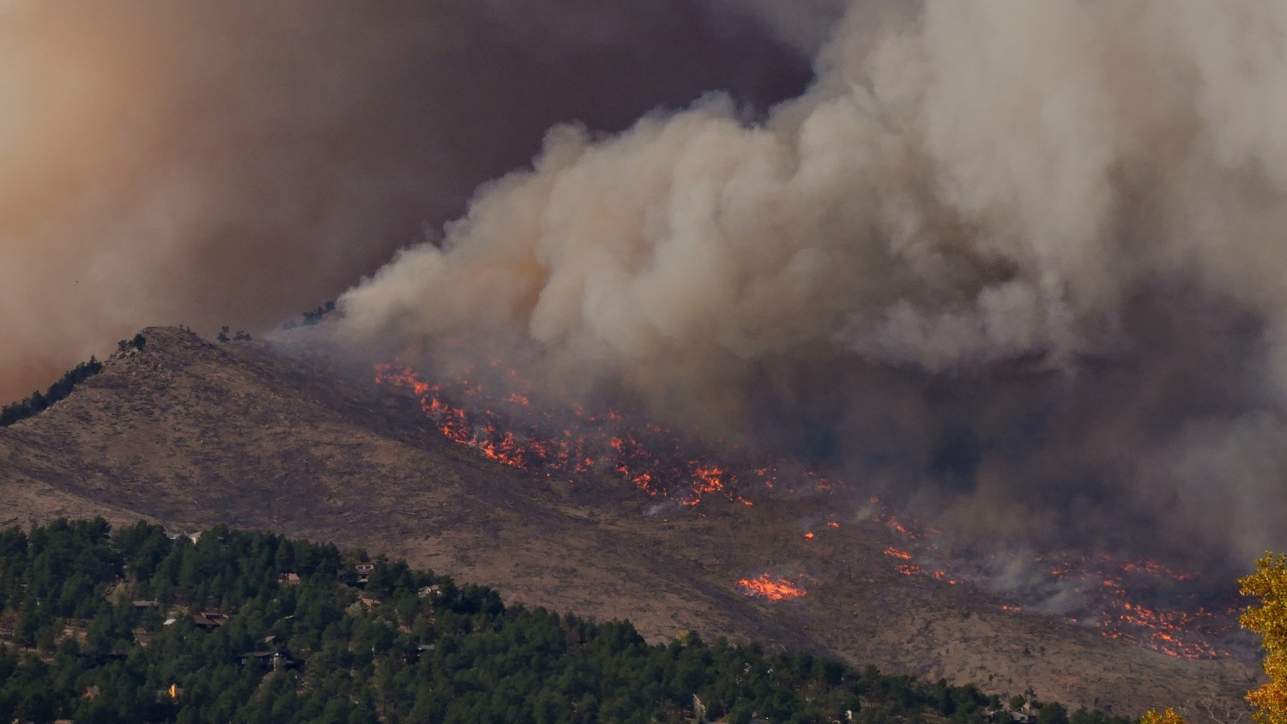
Analysis of wildfires due to Climate Change
By:
Alish Samuel
Hritik Mohan Dobriyal
Ankit Kumar (SKS)
Neha Jamatia

Slide 2
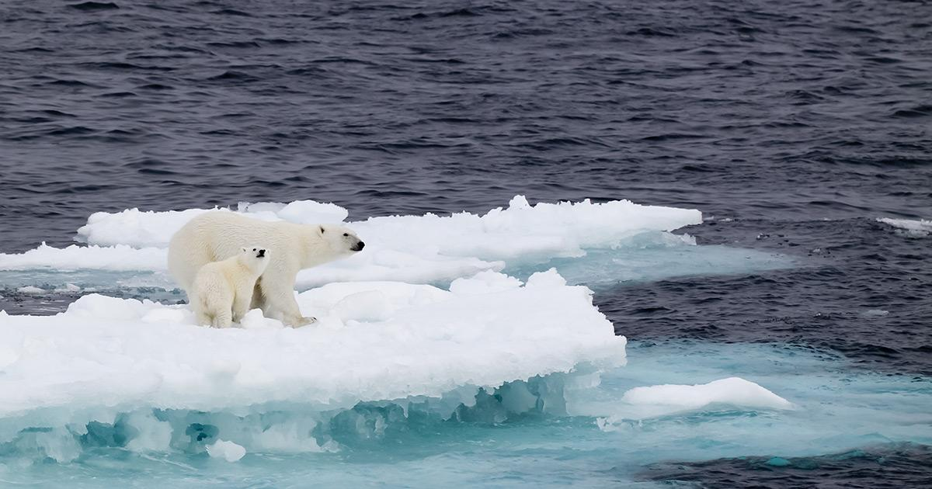
Problem Statement
To understand the relationship between Climate change and Wildfires.
To understand the origin, nature and insights into the effects caused by Climate Change.
To predict the damaged / burned area by wildfires in a floral region.

Slide 3
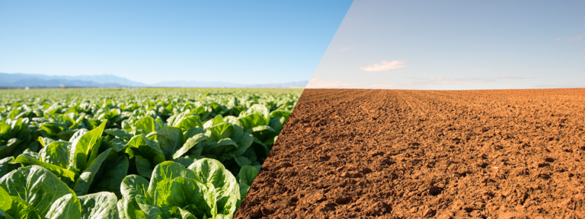
Motivation
Why are we witnessing a lot of wildfires recently?
Why are there many warnings related to breach of Paris Accord?
Why are we witnessing hottest years tags every year?
Are the wildfires man-made?
Can the damaged areas be predicted?

Slide 4
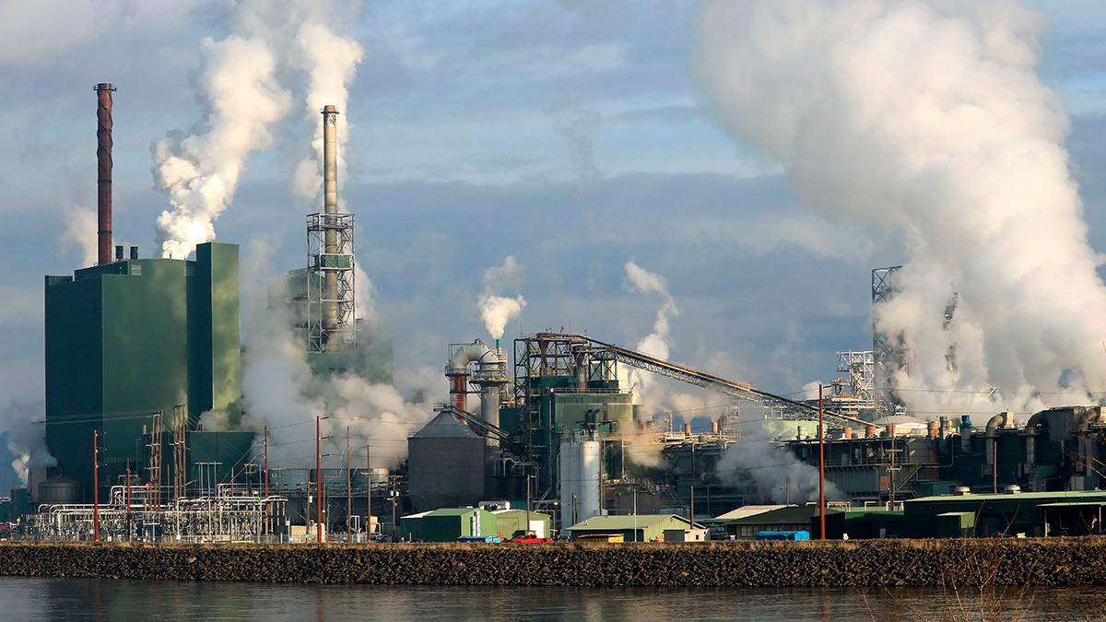
More on Motivation
More wildfires ∝ hot years on the way.
More global mean temperature, more hot climate, more imbalance in weather and climatic patterns.
More loss of trees if wildfires continue to occur, resulting in decline in forest covers.
Wastage of money if we don’t use Machine Learning on it to access the situation.

Slide 5
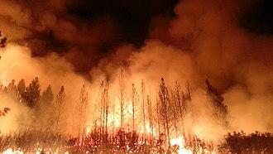
Data
Prime one, Forest fire dataset from UCI Machine Learning Repository.
Global Land-Ocean temperature Index dataset by NASA's Goddard Institute for Space Studies (GISS).
Total Greenhouse Gas Emissions (kt of CO2 emissions) by World Bank.

Slide 6

Tools Used
Python
NumPy
Pandas
Matplotlib
Seaborn
Tableau
Scikit-learn
Jupyter
Anaconda Software

Slide 7
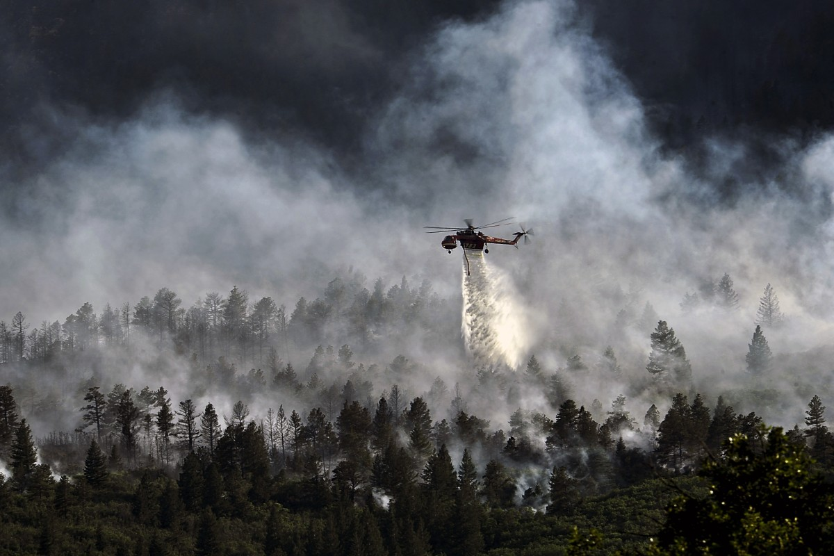
Advantages
To understand the relationship between climate change and wildfires.
Predicting the burned area of the forest after wildfire.
To use different Machine Learning algorithms for combatting this serious problem.
Prime one, to help the authorities deploy the forces accordingly to understand the situation the nature of wildfire and the scale of damage.

Slide 8

The End
Thank You!!!

